Slide 1

Data
Preprocessing
For Machine learning (II)

Slide 2
Session
Objectives
1
Pandas Group By operations on real-world data
2
split-apply-combine chain of operations works
3
concatenate for combining DataFrames across rows or columns
4
work with time-series data

Slide 3
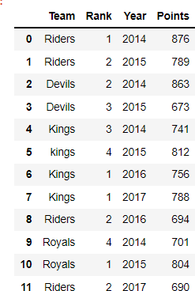
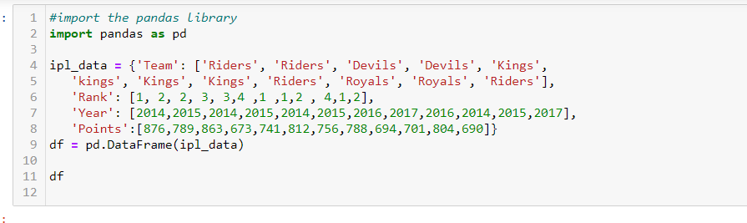
Pandas Group By operations on real-world data
Any groupby operation involves one of the following operations on the original object. They are : 1.Splitting the Object
2.Applying a function 3.Combining the results
In many situations, we split the data into sets and we apply some functionality on each subset. In the apply
functionality, we can perform the following operations −
Aggregation − computing a summary statistic
Apply , Transformation − perform some group-specific operation
Filtration − discarding the data with some condition

Slide 4
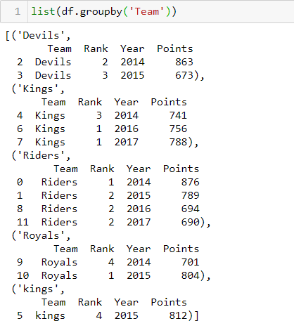
1.Splitting
Pandas object can be split into any of their objects. There are multiple ways to split
an object like −
obj.groupby('key')
obj.groupby(['key1','key2'])
Key: column name
Let us now see how the grouping objects can be applied to the DataFrame object

Slide 5
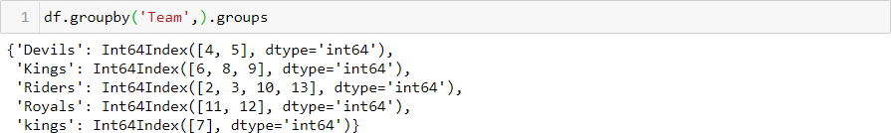
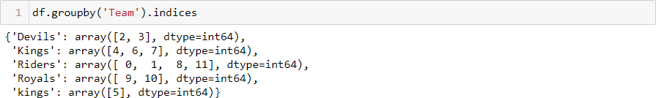
groupby.groups : return dict(group name , group labels)
groupby.indices :return dict(group name , group index)

Slide 6
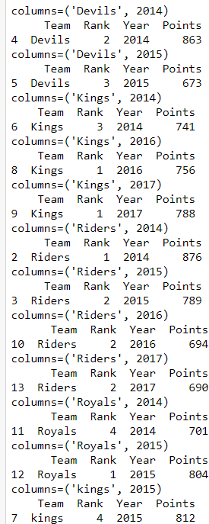

Group by with multiple columns

Slide 7
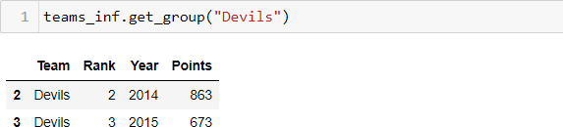
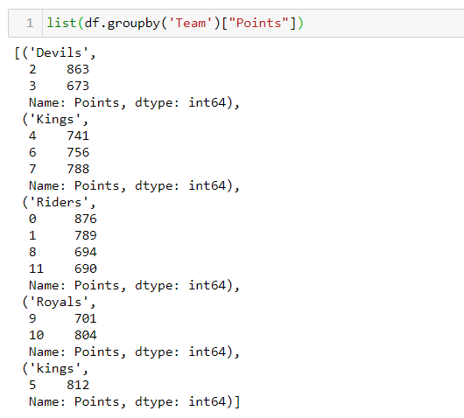
Select a Group
Using the get_group() method, we can select a single group.
select certain column after grouping the data
or

Slide 8
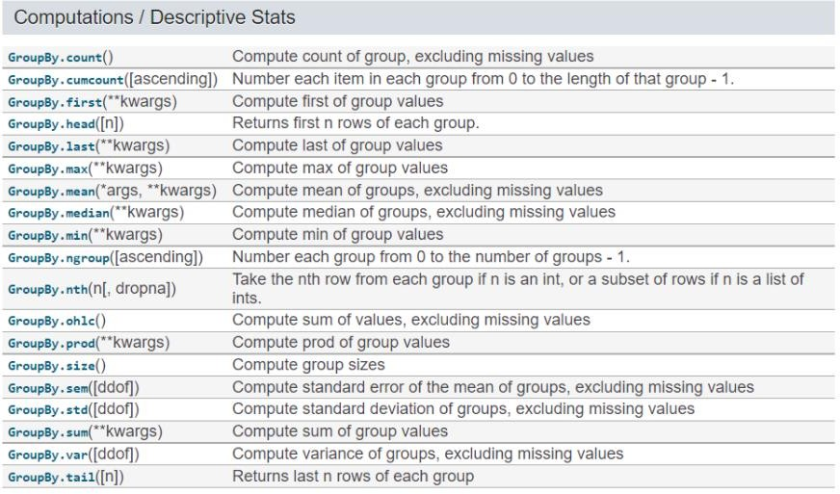
Applying a function
Combining the results

Slide 9
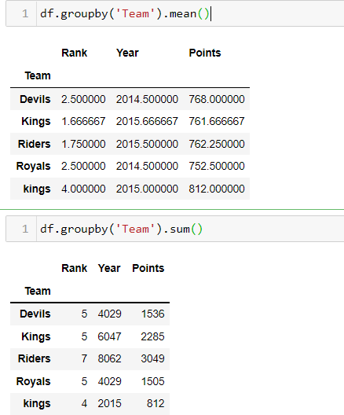
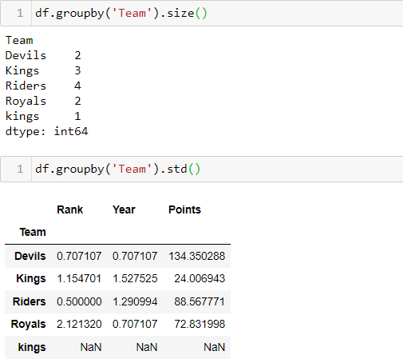
Statistical Operation on groupby( )

Slide 10
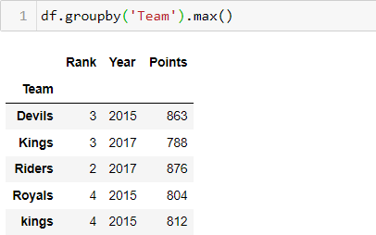
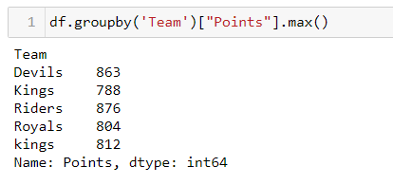
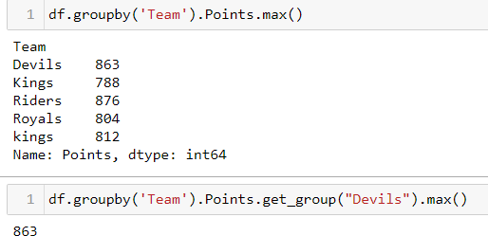
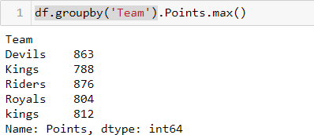
Statistical Operation on groupby( ) ( Continued )

Slide 11
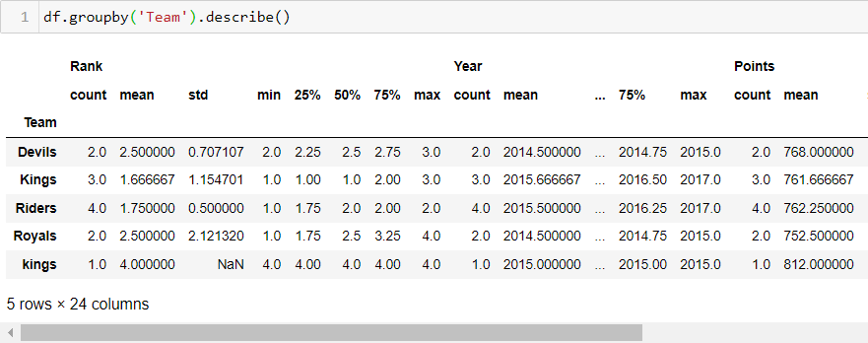
Get the main statistics information per group

Slide 12
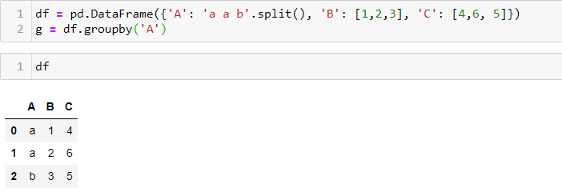
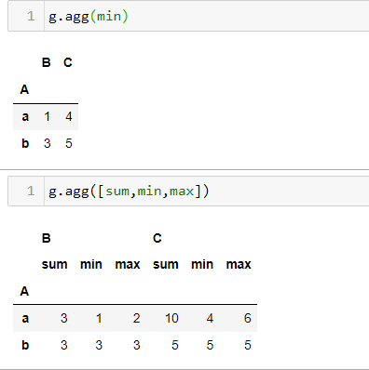
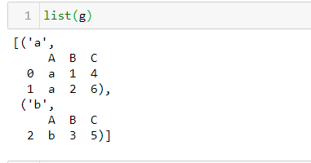
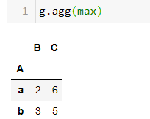
Aggregations
An aggregated function returns a single aggregated value for each group. Once the group by object is created, several aggregation operations can be performed on the grouped data.
An obvious one is aggregation via the aggregate or equivalent agg method:

Slide 13
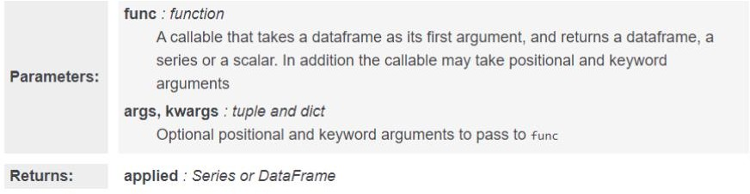
2. apply , transform
GroupBy.apply(func, args, *kwargs)
GroupBy.transform(func, args, *kwargs)

Slide 14
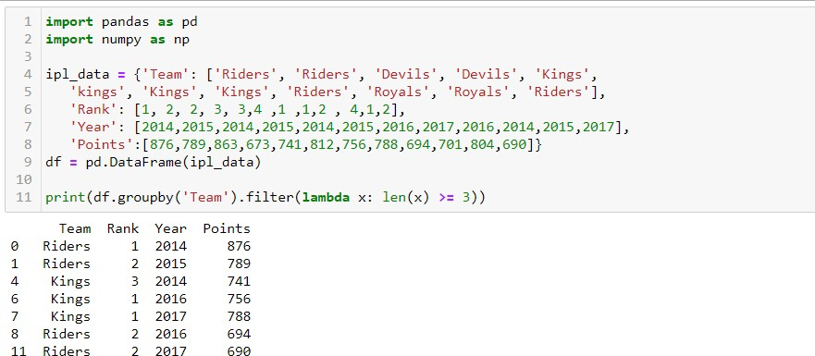
3- Filtration
Filtration filters the data on a defined criteria and returns the subset of data. The filter() function is used to filter the data.

Slide 15
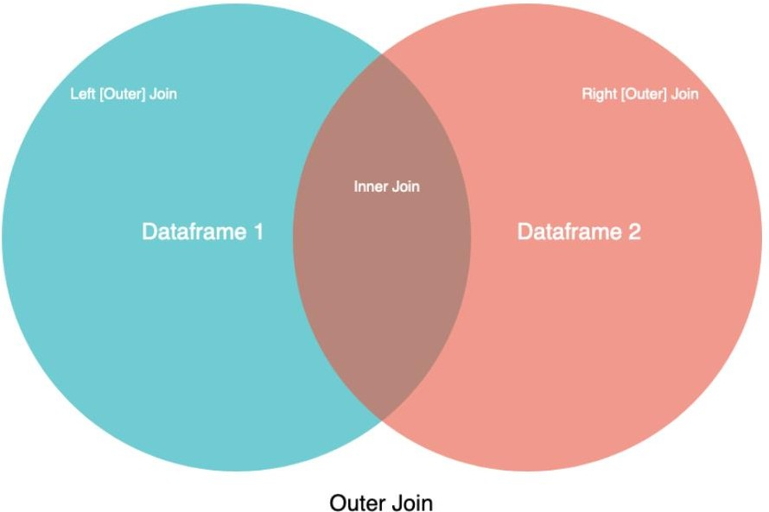
concatenate for combining DataFrames across rows or columns
Concat :
One way to combine or concatenate DataFrames is concat() function. It can be used to concatenate DataFrames along rows or
columns by changing the axis parameter. The default value of the axis parameter is 0, which indicates combining along rows.

Slide 16
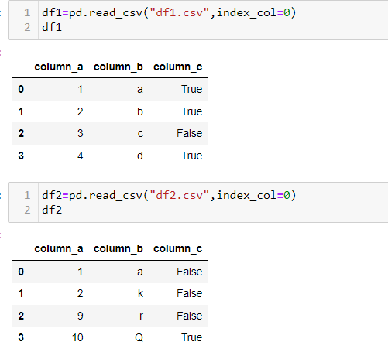
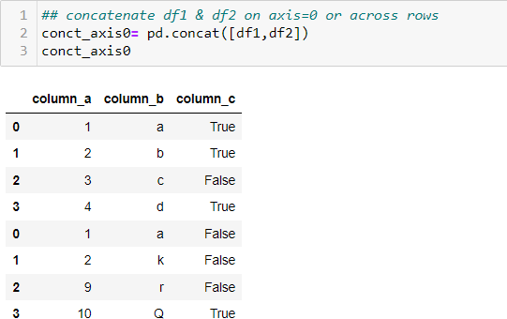
The default value of the axis parameter is 0, which indicates combining along rows.

Slide 17
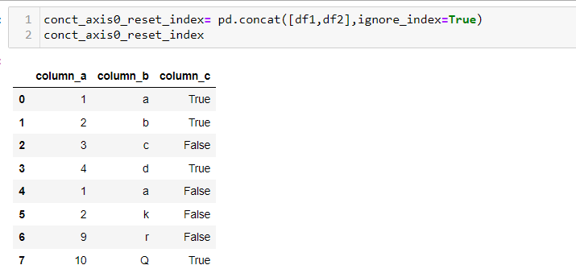
The indices of individual DataFrames are kept.
In order to change it and re-index the combined DataFrame,
ignore_index parameter is set as True

Slide 18
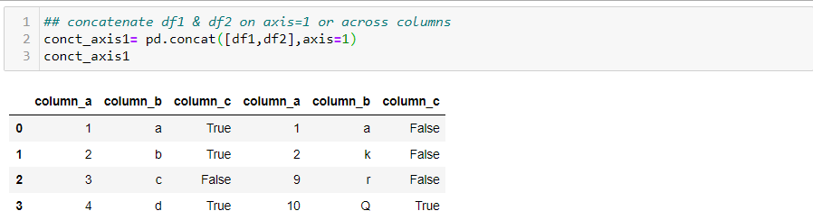
Concatenate Dataframes across column by setting ( axis=1):

Slide 19
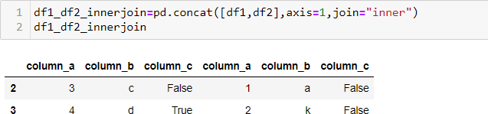
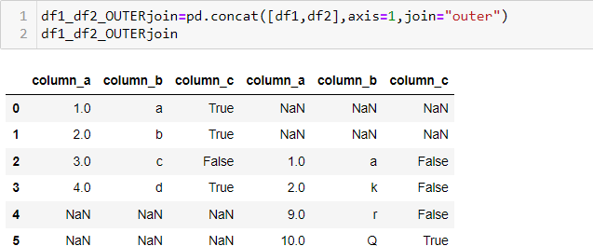
1. inner join
2. Outer join

Slide 20
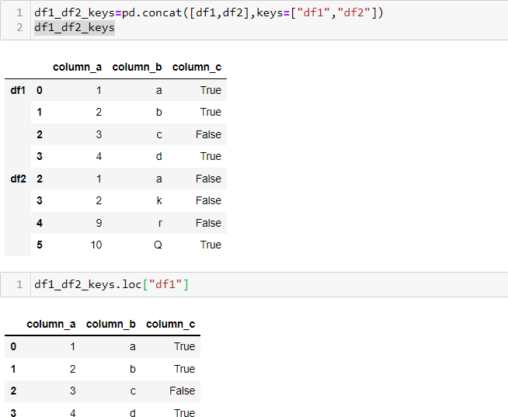
Pandas also provides ways to label DataFrames so that we know which part comes from which DataFrame. We just pass the list of combined DataFrames in order
using keys parameter

Slide 21
work with time-series data
Pandas was developed in the context of financial modeling, so as you might expect, it contains a fairly extensive set of tools for working with dates, times, and time-indexed data. Date and time data comes in a few flavors, which we will discuss here:
Time stamps reference particular moments in time (e.g., July 4th, 2015 at 7:00am).
Time intervals and periods reference a length of time between a particular beginning and end point; for example, the year 2015. Periods usually reference a special case of time intervals in which each interval is of uniform length and does not overlap (e.g., 24 hour-long periods comprising days).
Time deltas or durations reference an exact length of time (e.g., a duration of 22.56 seconds).

Slide 22
Convert our date columns to datetime
Now that we know that our date column isn't being recognized as a date, it's time to convert it so that it is recognized as a date. This is called "parsing dates" because we're taking in a string and identifying its component parts.
We can pandas what the format of our dates are with a guide called as "strftime directive", which you can find more information on at this link. The basic idea is that you need to point out which parts of the date are where and what punctuation is between them. There are lots of possible parts of a date, but the most common are %d for day, %m for month, %y for a two-digit year and %Y for a four digit year.
Some examples:
1/17/07 has the format "%m/%d/%y" 17-1-2007 has the format "%d-%m-%Y“
Looking back up at the head of the "date" column in the landslides dataset, we can see that it's in the format "month/day/two-digit year"

